Slide 1

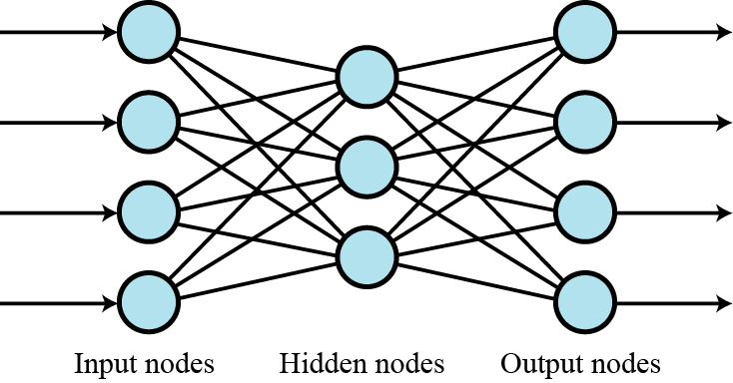
Multi-layer networks
Several layers of neurons can be combined to create multilayer neural networks. The output from each layer becomes the input to the next layer. The first layer is called the input layer, the middle layers are called the hidden layers and the last layer is called the output layer.
Figure A multi-layer neural network

Slide 2
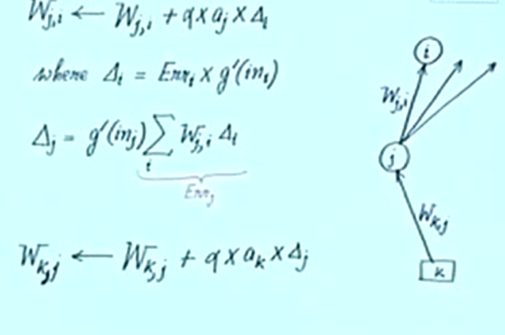
Multi layer

Slide 3
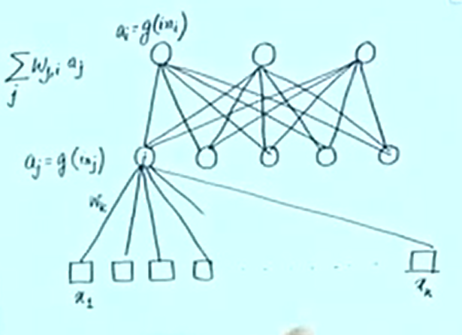
Learning Multi layer

Slide 4
Back Propagation Algorithm
PHASE – I ➔Feed Forward Phase
Hidden Unit
Net Input
Output
Output Unit
Net Input
Output
PHASE – II ➔ Back Propagation of Error
Output Unit
Error Calculation
Change in weights and bias
Hidden unit
Net delta input
Error Calculation
Change in weights and bias
PHASE – III ➔ Weight and bias updation
Output Unit
Weight and Bias Updation
Hidden Unit
Weight and Bias Updation
4

Slide 5
DESIGN PARAMETERS
Number of Training/Testing Data
Nature of Training
Selection of Network Structure
Weights and Bias
Learning Rate
Termination Criteria
Goal and Epoch
Overfitting/Overtraining
Generalization

Slide 6
STEPS OF DEVELOPING AN ANN MODEL
Loading the data set
Separating the data set into Training and Testing Data
Defining the network structure
Setting initial values for weights and bias
Training the network
Testing the network
Displaying the result

